Slide 1

PROBLEM SOLVING WITH C LABORATORY (UE19CS152)
MINI-PROJECT PHASE -2

Slide 2
PROJECT TITLE - PLAY FAIR CIPHER
Course Title: Problem Solving with C Laboratory
Course code: UE19CS152
Semester : II sem | Section:Q | Team Id:13
SRN:PES1UG19CS291 | Name:SANJANA NASALAI
SRN:PES1UG19CS119 | Name:CHAITRA B KAYI
SRN:PES1UG19EC246 | Name:SAMPRITHI S P
SRN:PESIUG19CV008 | Name:AMRITA J SINGH

Slide 3

Description
In order to encrypt using the play fair cipher, a polybias square is drawn using a keyword. Firstly, the plain text is split into diagraph.
If two letters appear on same row, then replace each letter by the letter immediately to the right. If two letters appear on the same column, then replace the letter by the letter immediately below it. Otherwise, if two letters from the corners of a rectangle, then they are replaced by the corners present on the same row.
Encryption Technique
For the encryption process let us consider the following example:
The Playfair Cipher Encryption Algorithm: The Algorithm consistes of 2 steps:
Generate the key Square(5×5):
The key square is a 5×5 grid of alphabets that acts as the key for encrypting the plaintext. Each of the 25 alphabets must be unique and one letter of the alphabet (usually J) is omitted from the table (as the table can hold only 25 alphabets). If the plaintext contains J, then it is replaced by I.
The initial alphabets in the key square are the unique alphabets of the key in the order in which they appear followed by the remaining letters of the alphabet in order.

Slide 4
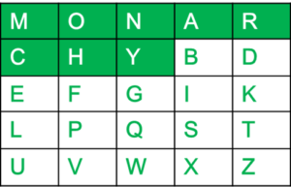
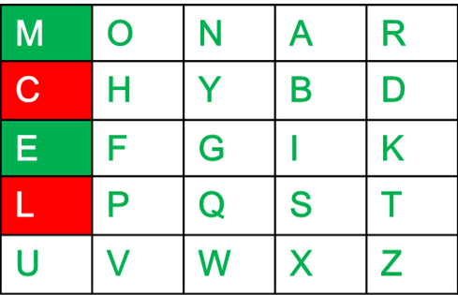
For example:
The key is "monarchy" Thus the initial entires are 'm', 'o', 'n', 'a', 'r', 'c', 'h', 'y' followed by remaining characters of a-z(except 'j') in that order.
Algorithm to encrypt the plain text: The plaintext is split into pairs of two letters (digraphs). If there is an odd number of letters, a Z is added to the last letter.
For example:
PlainText: "instruments" After Split: 'in' 'st' 'ru' 'me' 'nt' 'sz'
Rules for Encryption:
If both the letters are in the same column: Take the letter below each one (going back to the top if at the bottom).
For example:
Diagraph: "me" Encrypted Text: cl Encryption: m -> c e -> l

Slide 5
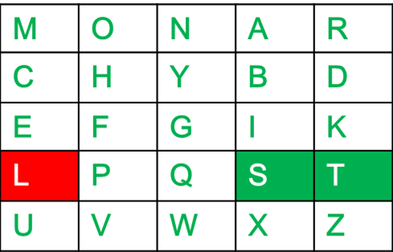
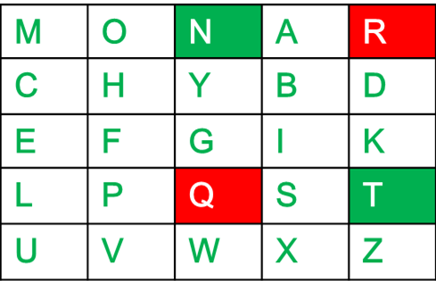
If both the letters are in the same row: Take the letter to the right of each one (going back to the leftmost if at the rightmost position).For example:
Diagraph: "st" Encrypted Text: tl Encryption: s -> t t -> l
If neither of the above rules is true: Form a rectangle with the two letters and take the letters on the horizontal opposite corner of the rectangle.
For example:
Diagraph: "nt" Encrypted Text: rq Encryption: n -> r t -> q

Slide 6
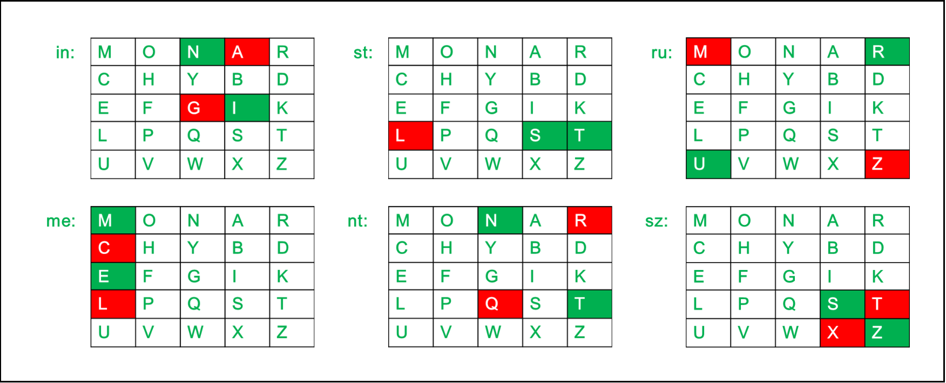
For example:
Plain Text: "instrumentsz" Encrypted Text: gatlmzclrqtx Encryption:
i -> g n -> a s -> t t -> l r -> m u -> z m -> c e -> l n -> r t -> q s -> t z -> x

Slide 7
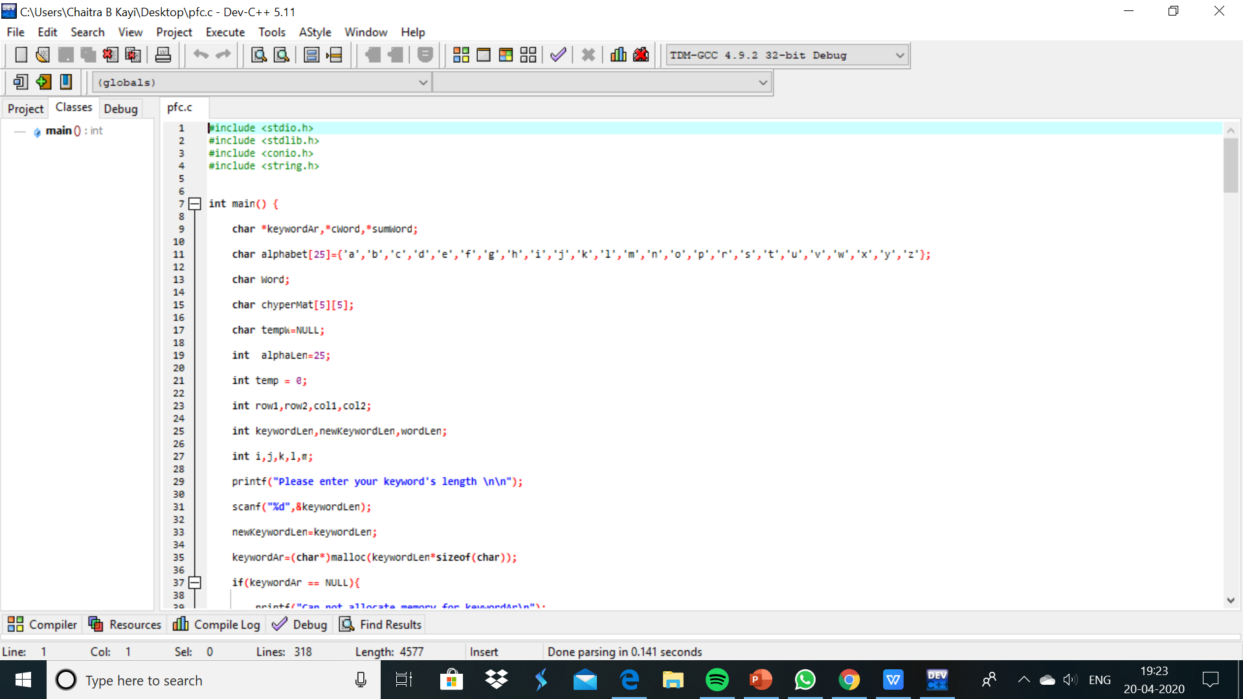

Slide 8
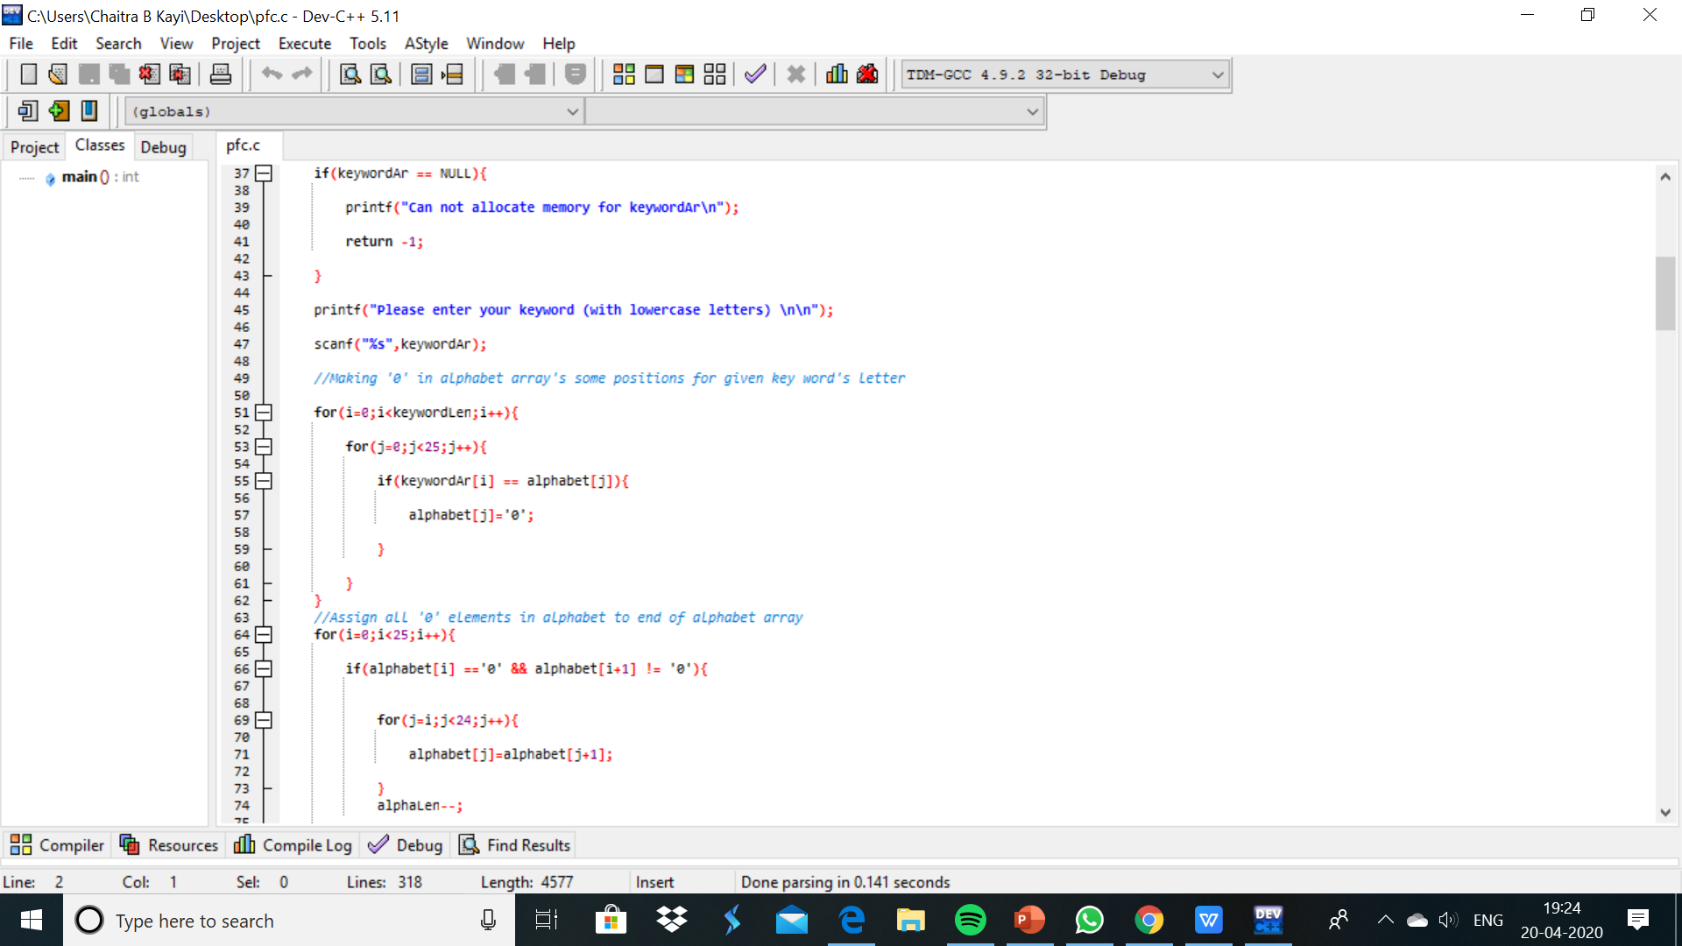

Slide 9
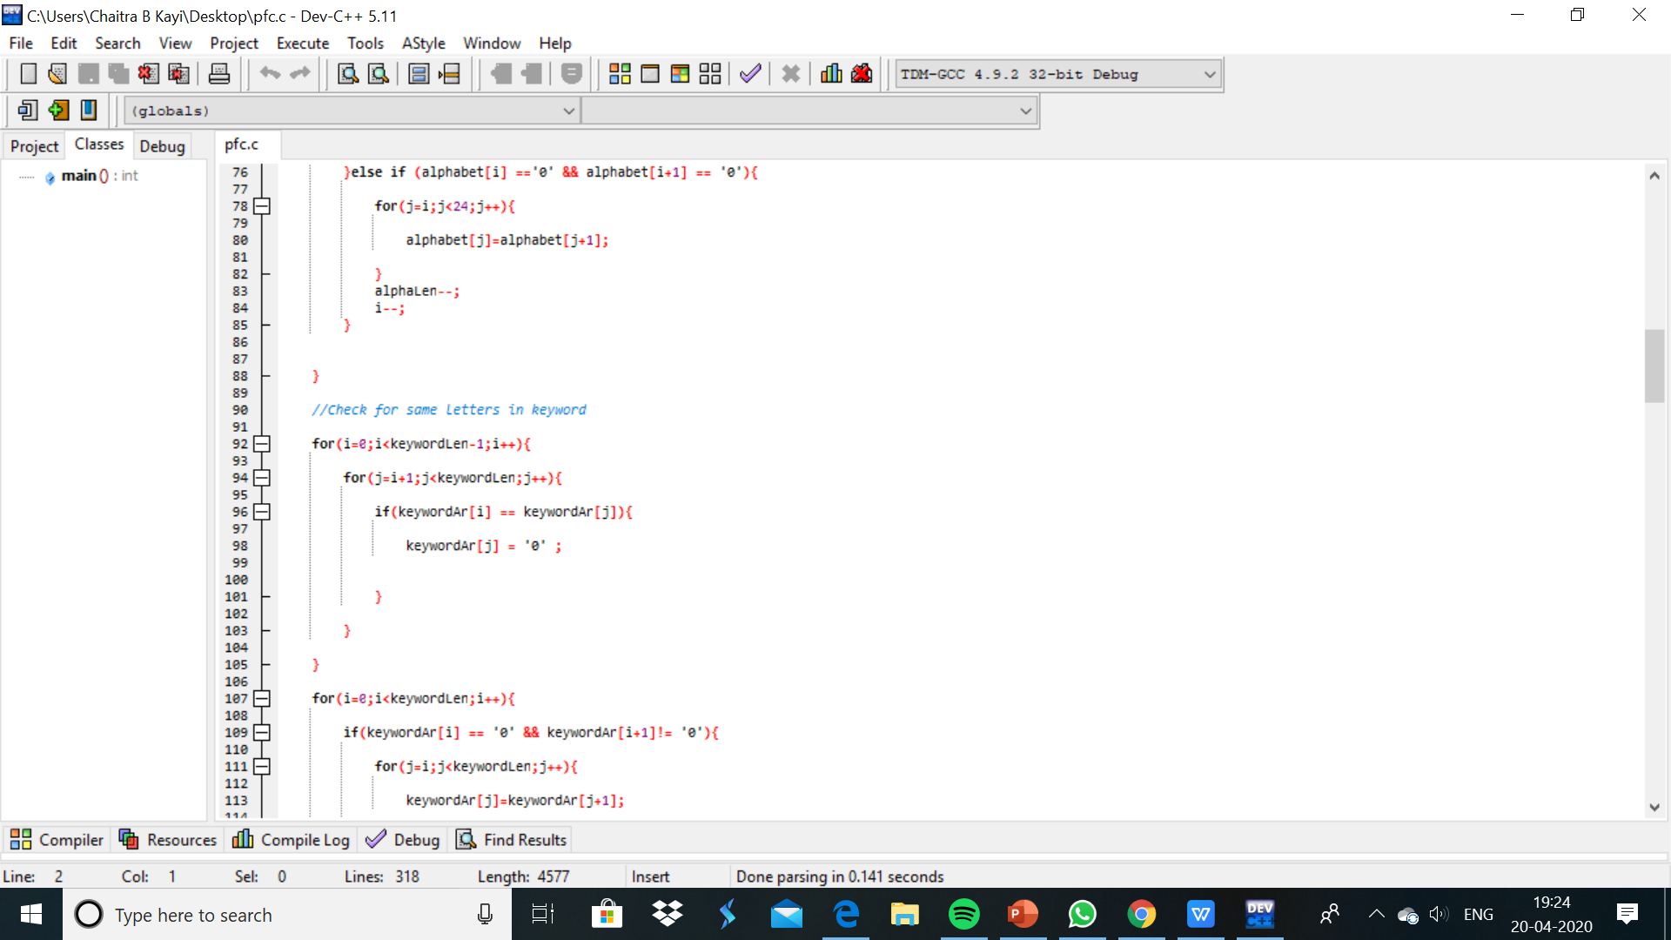

Slide 10
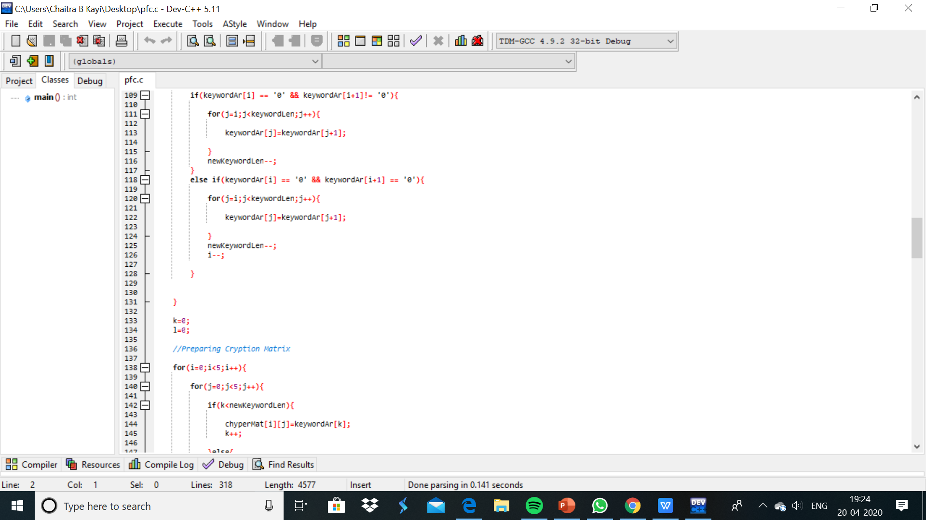

Slide 11
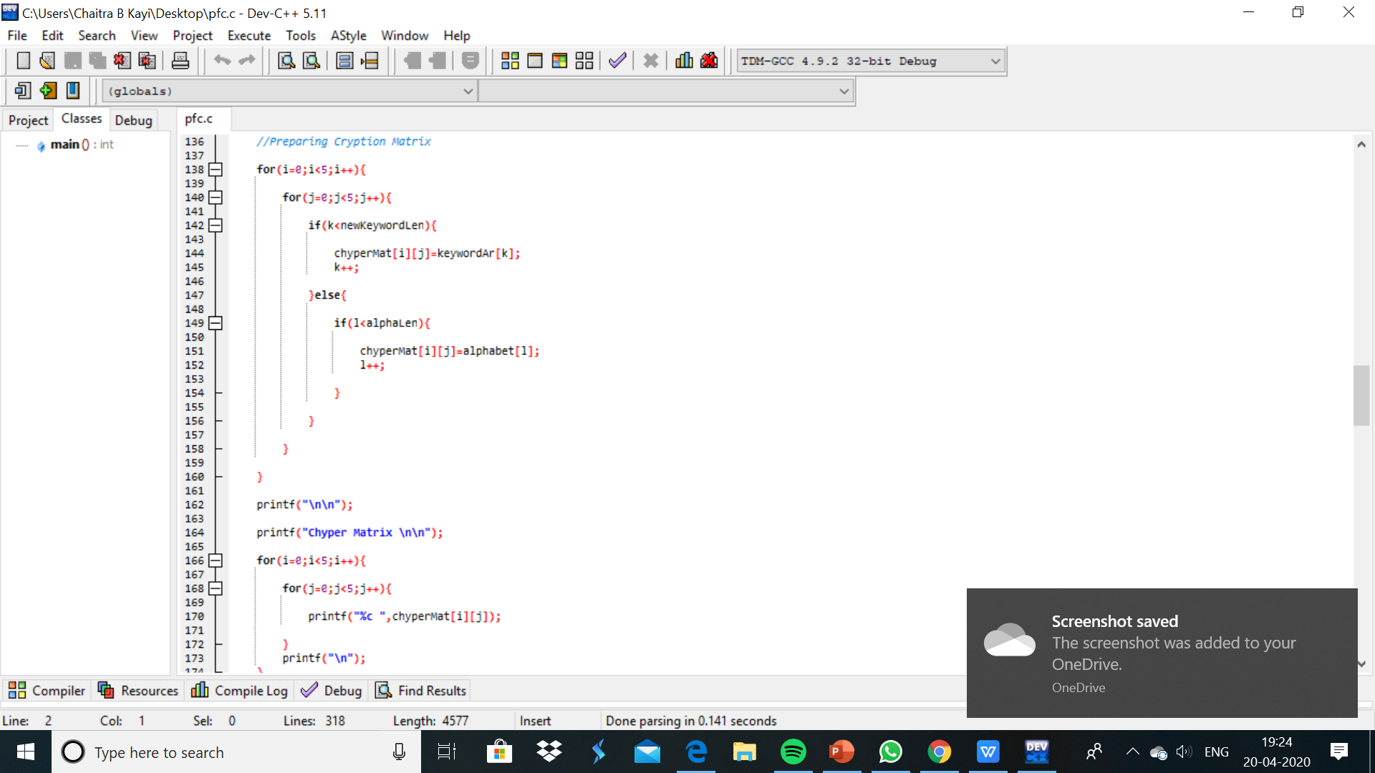

Slide 12
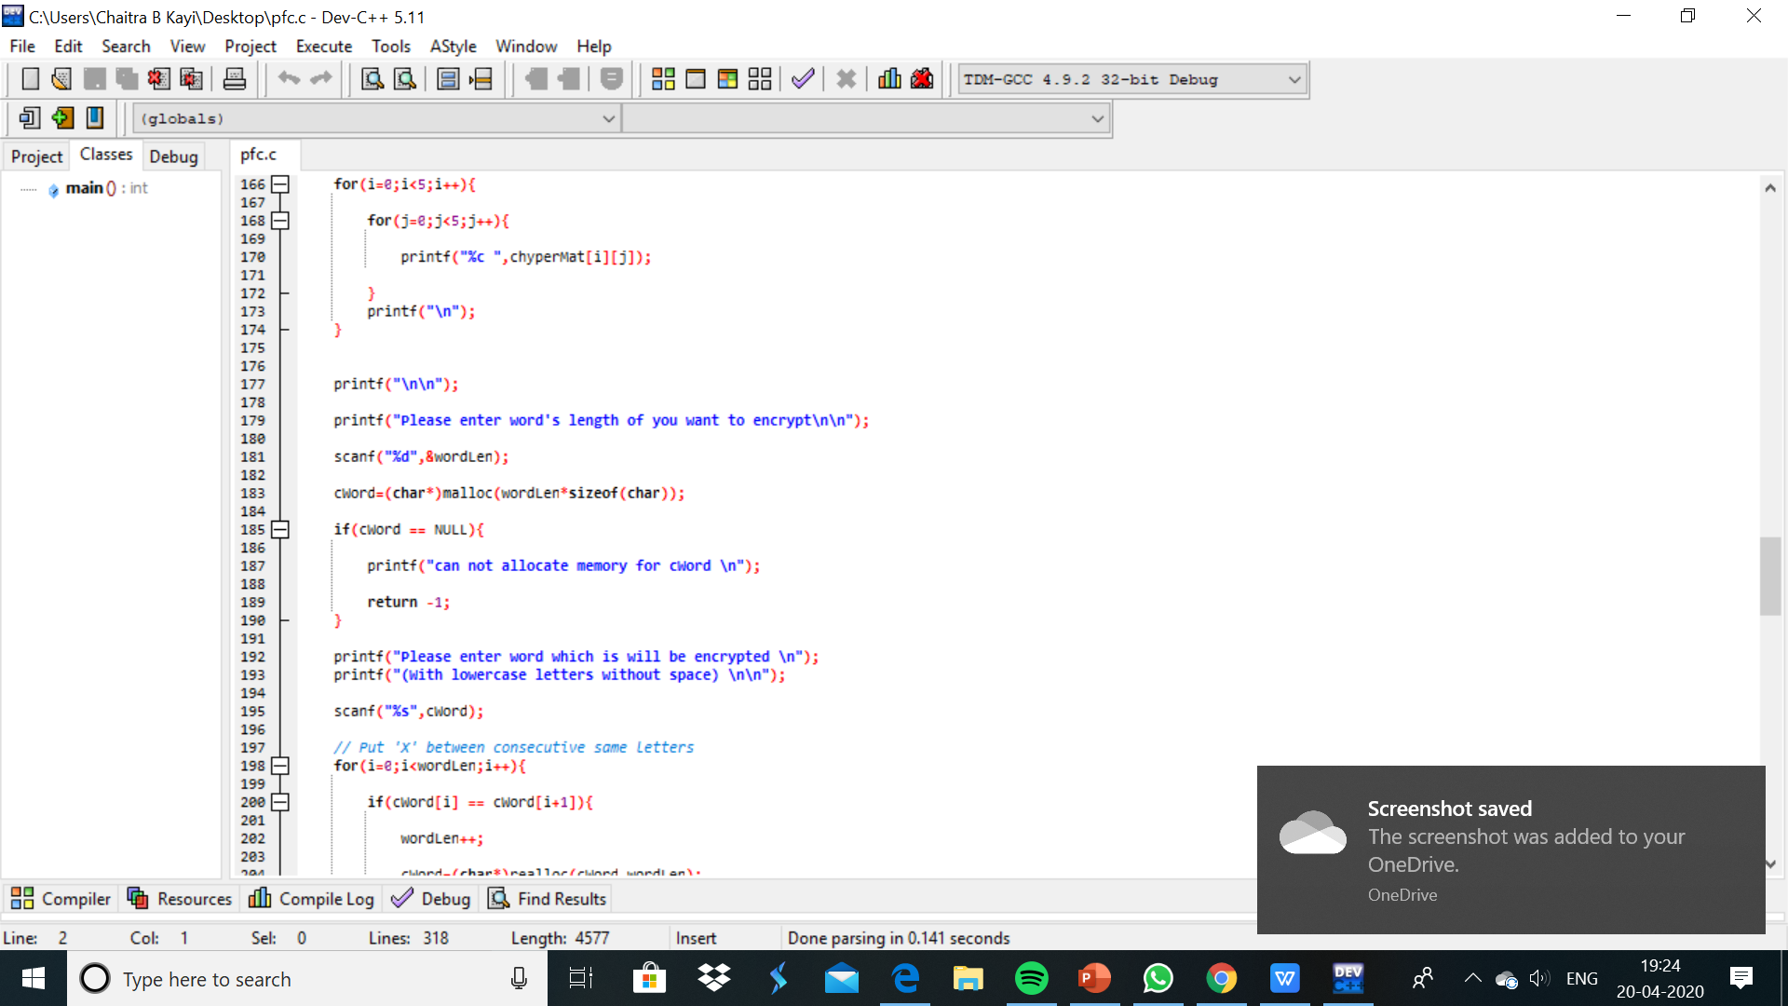

Slide 13
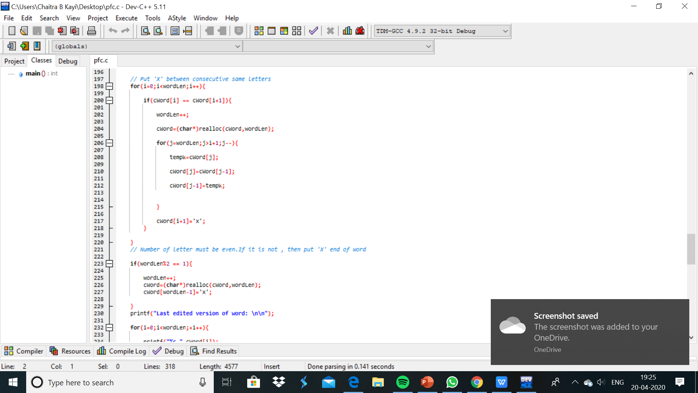

Slide 14
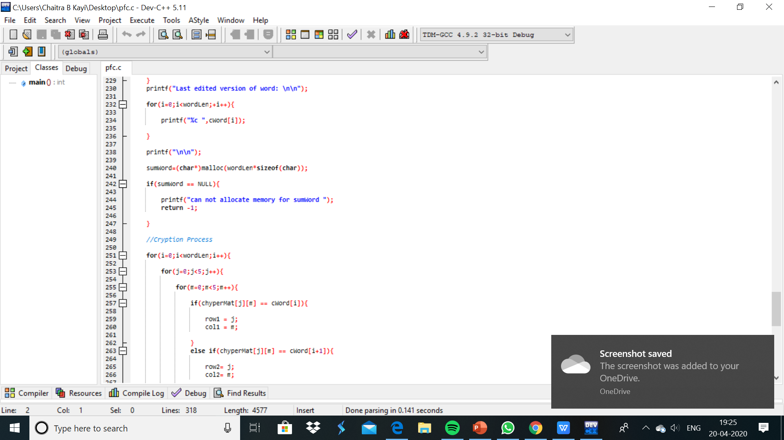

Slide 15
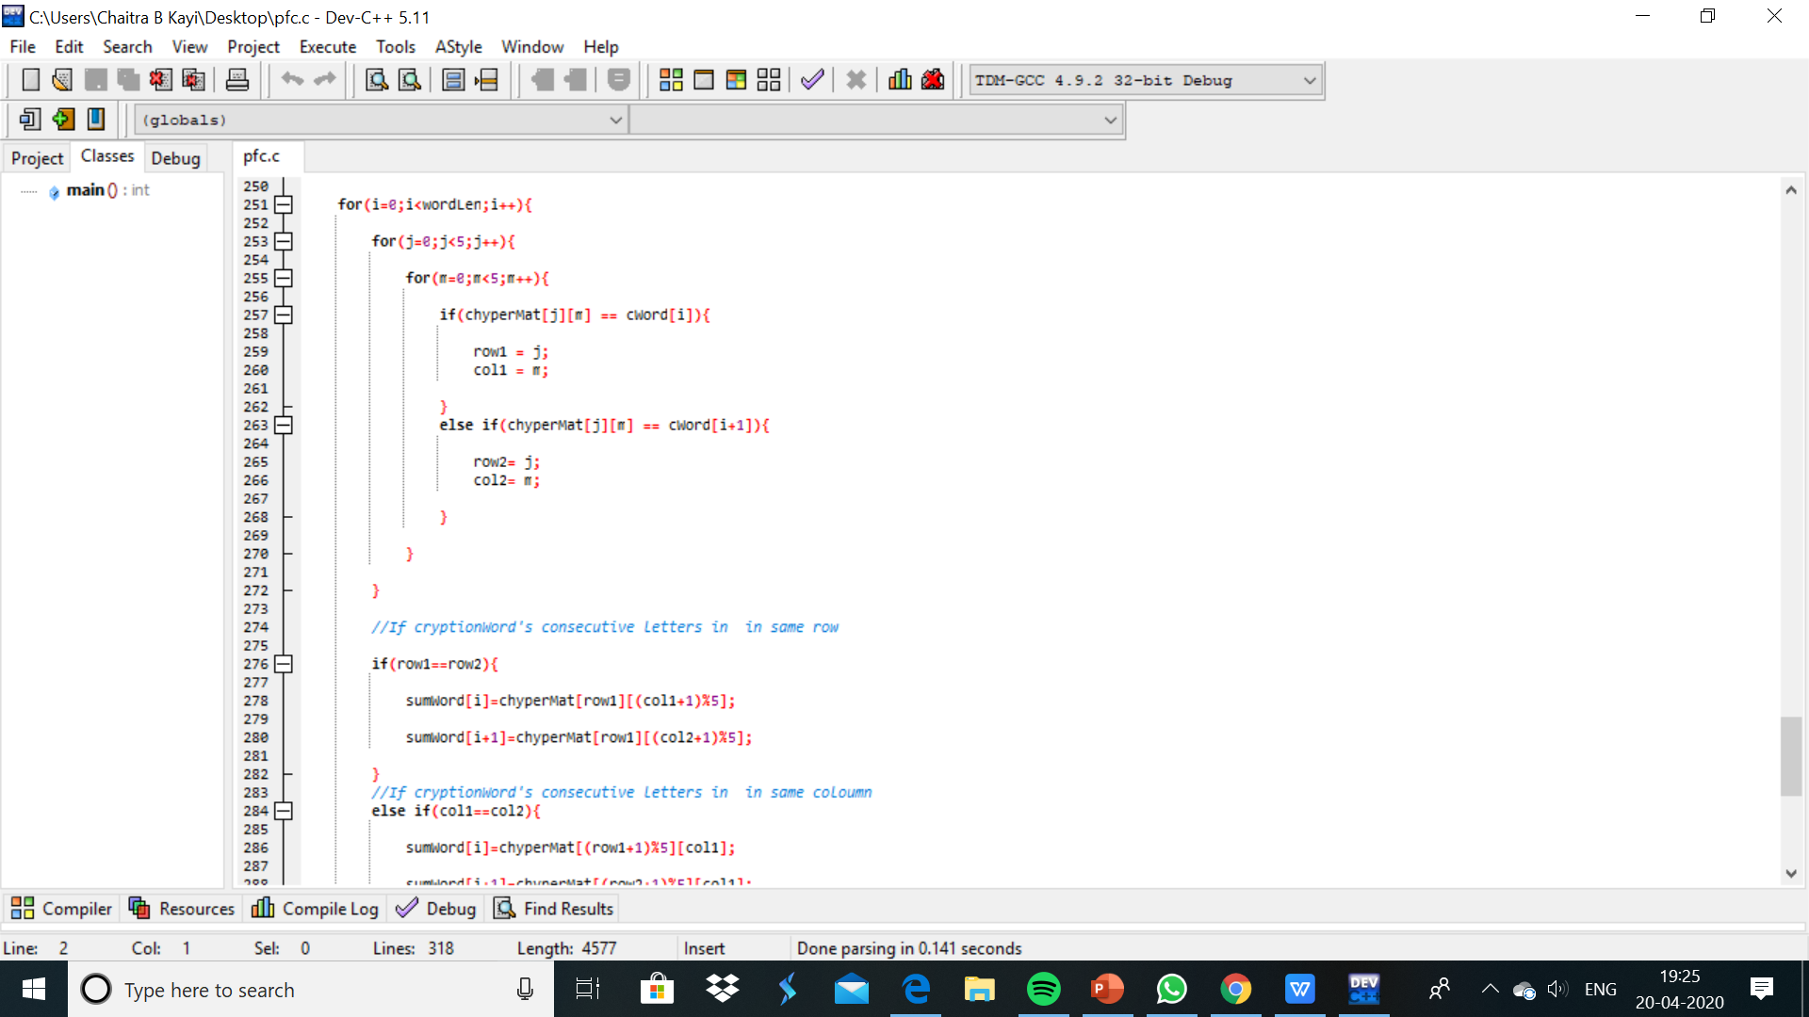

Slide 16
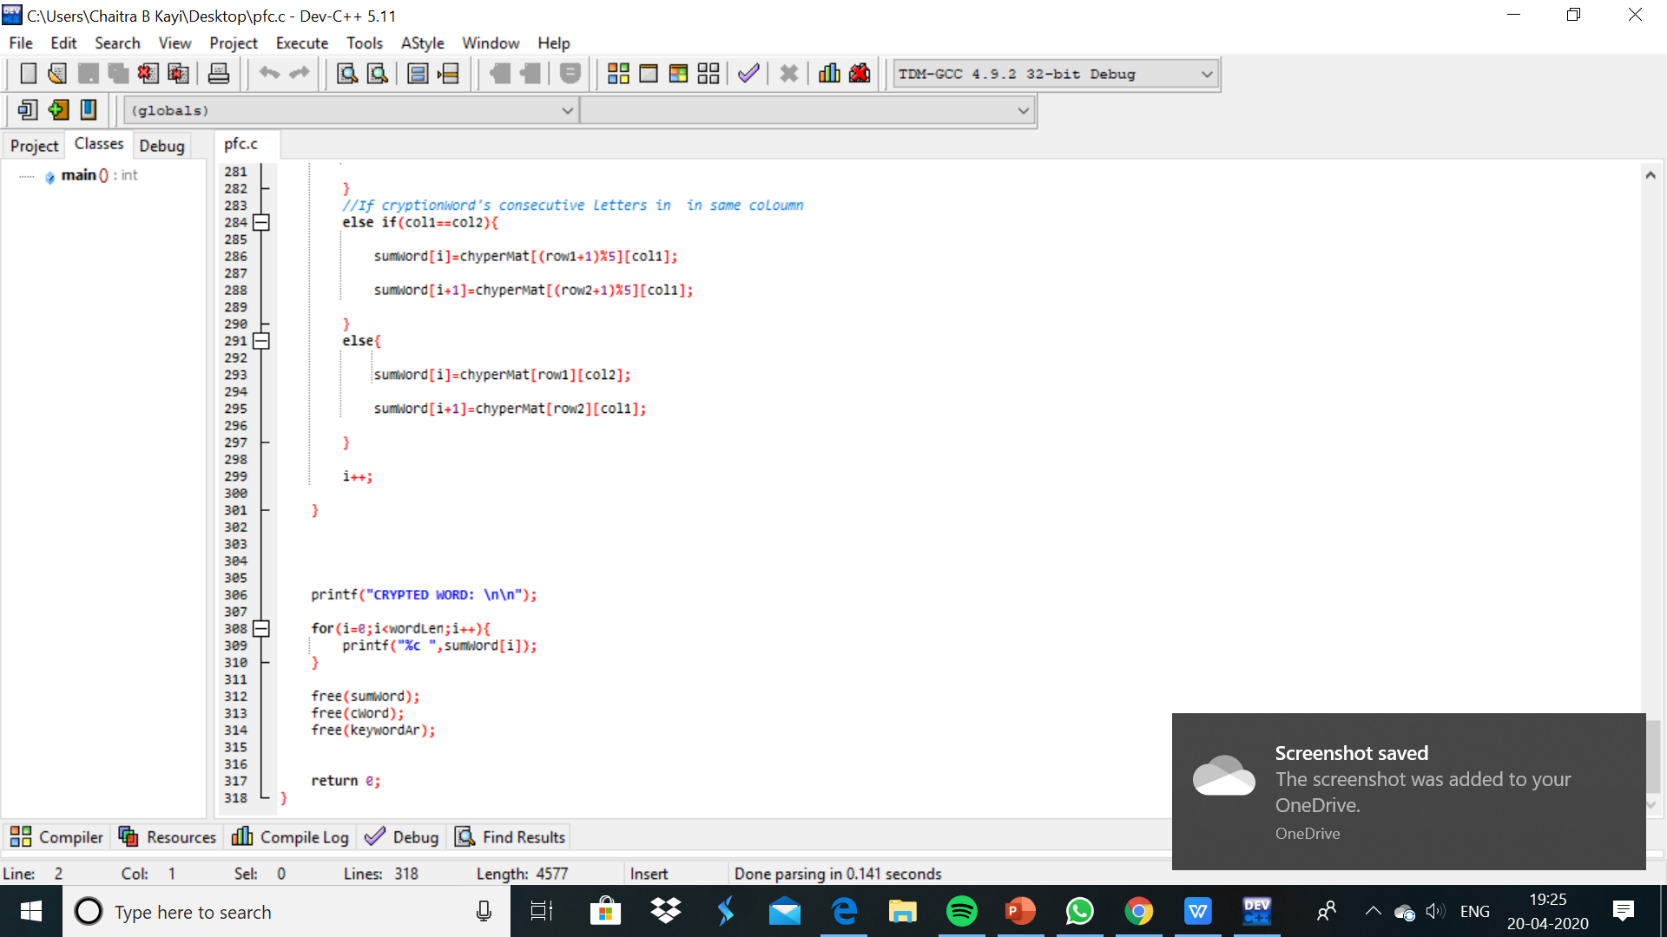

Slide 17
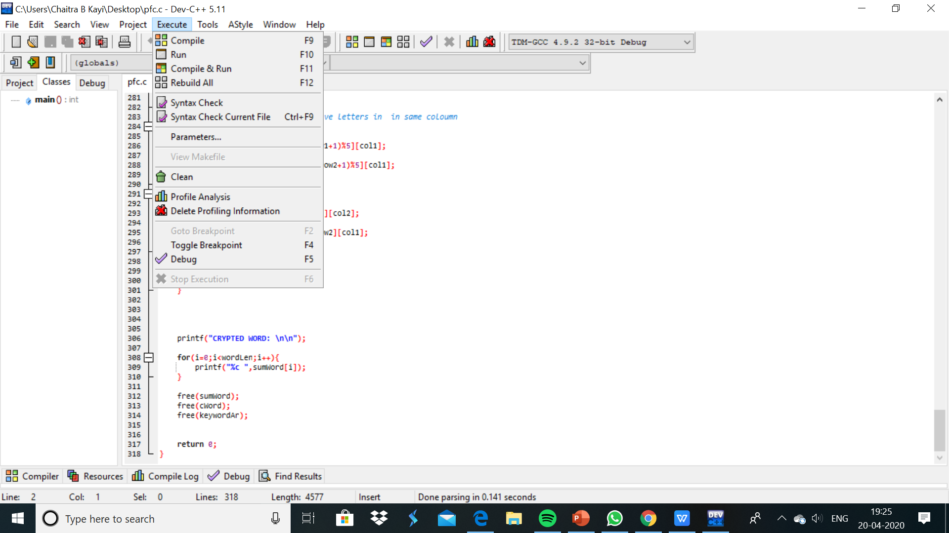

Slide 18
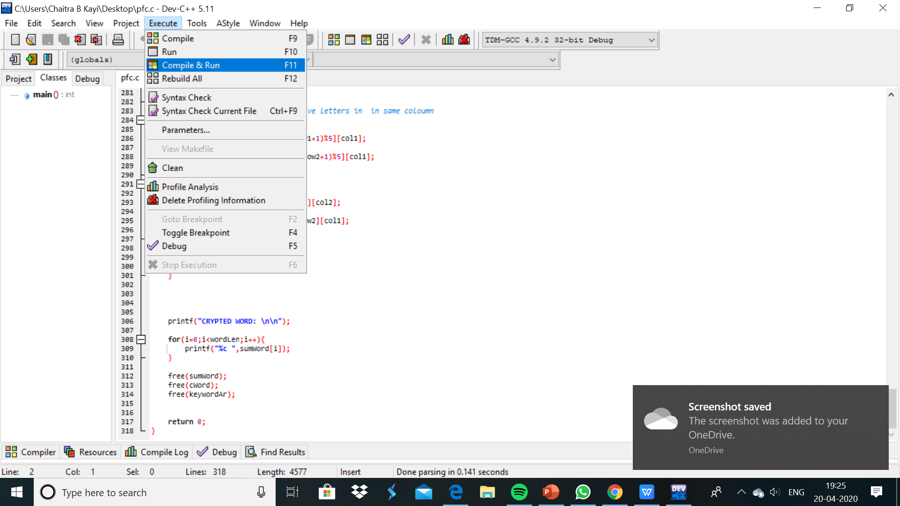

Slide 19
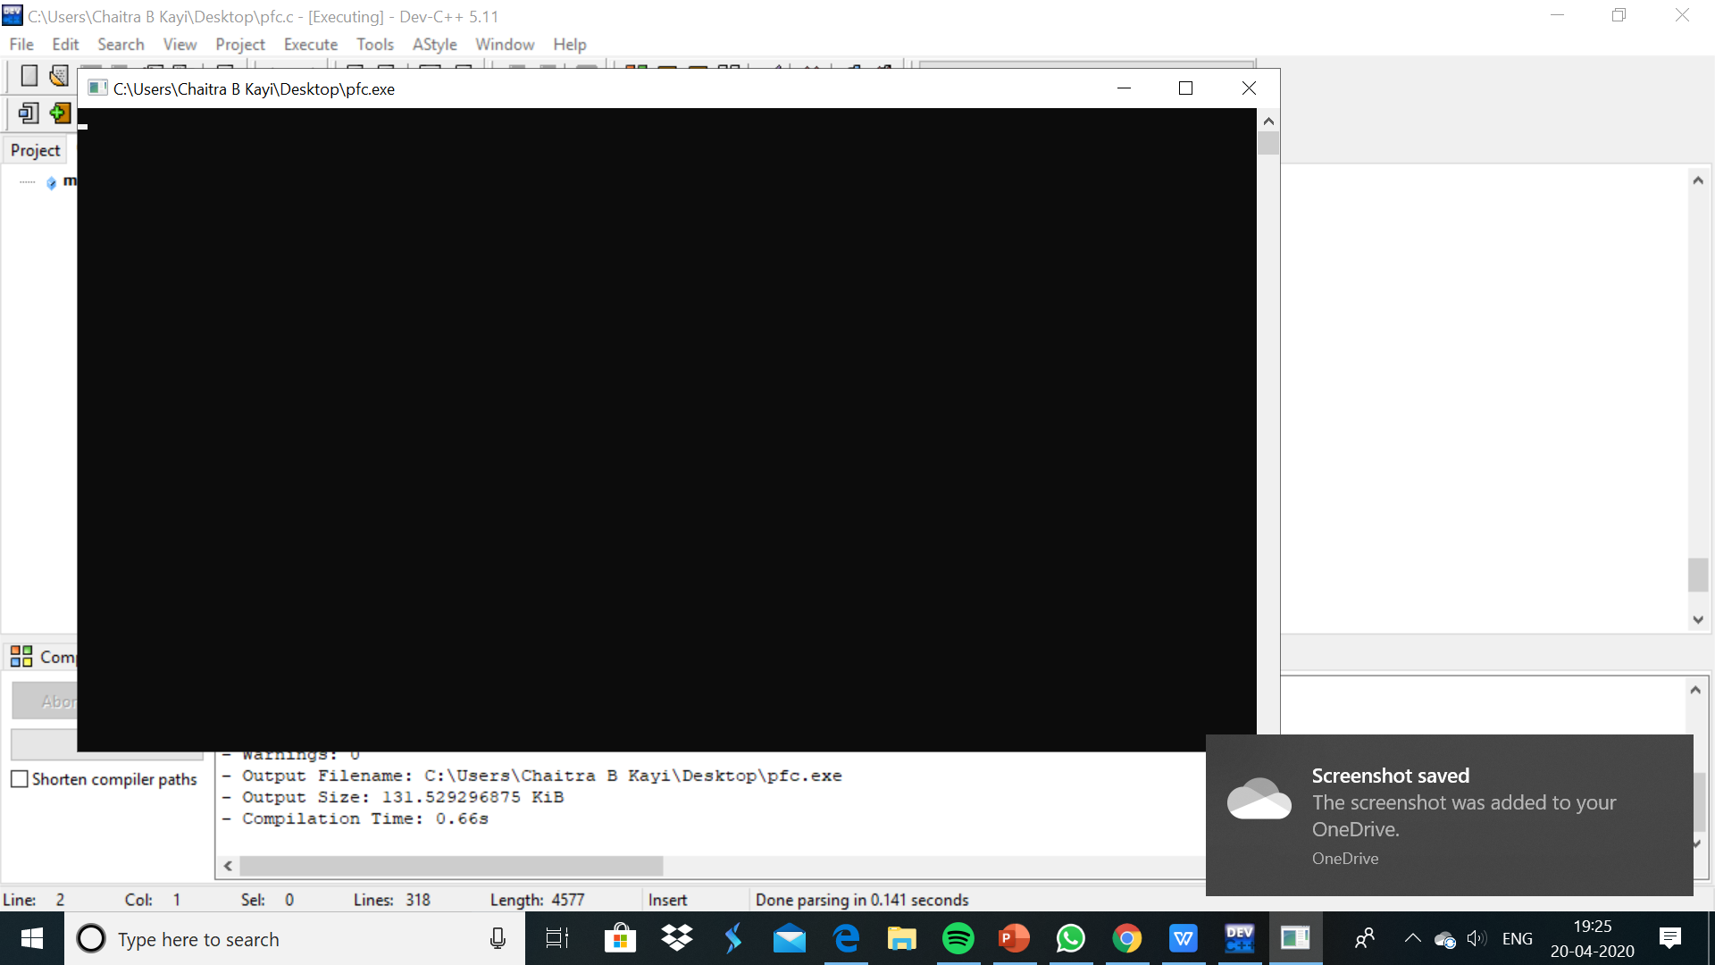

Slide 20


Slide 21


Slide 22
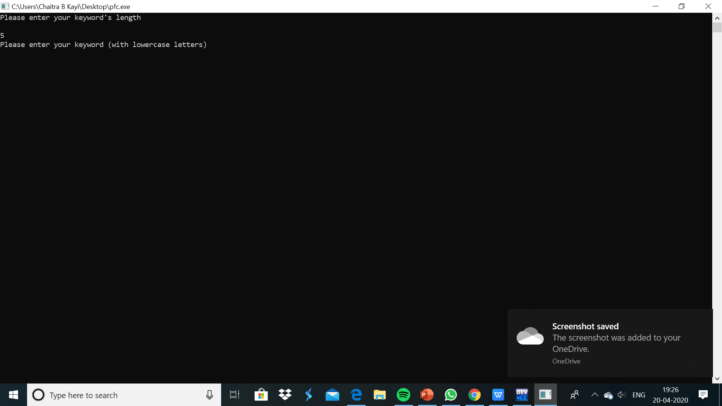

Slide 23
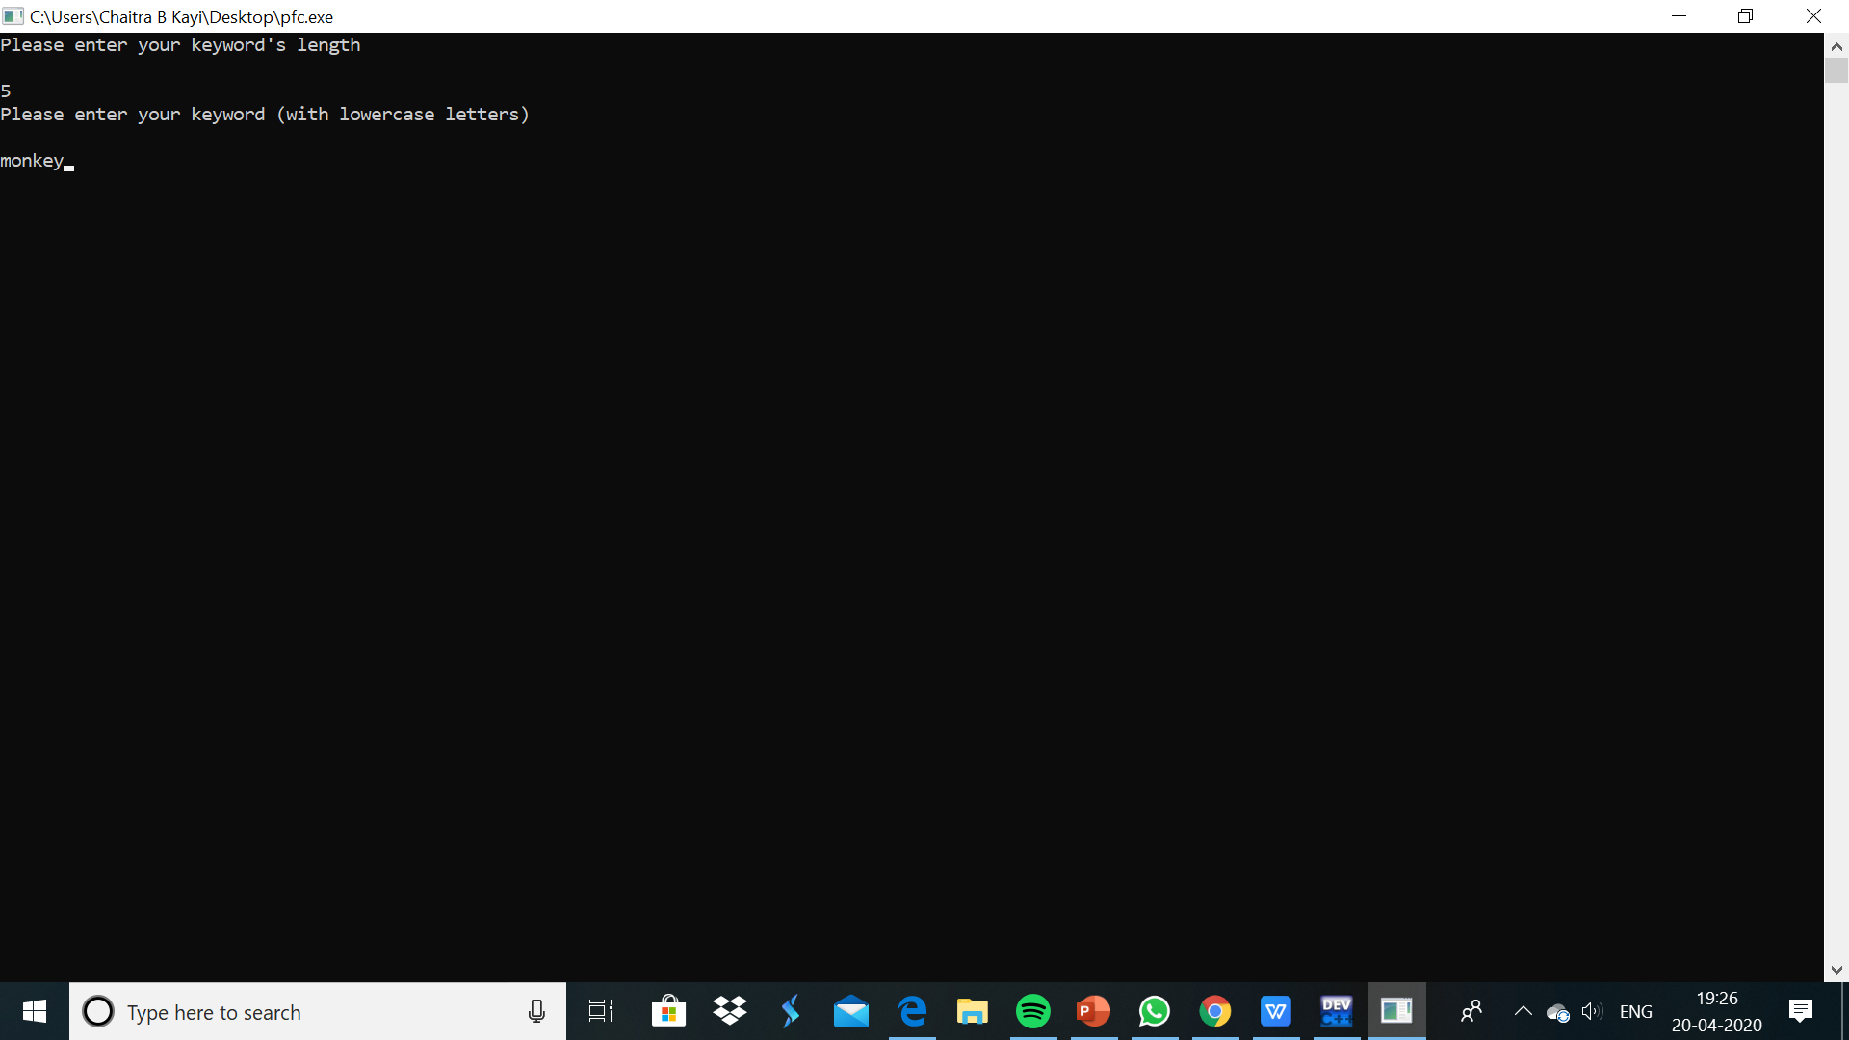

Slide 24
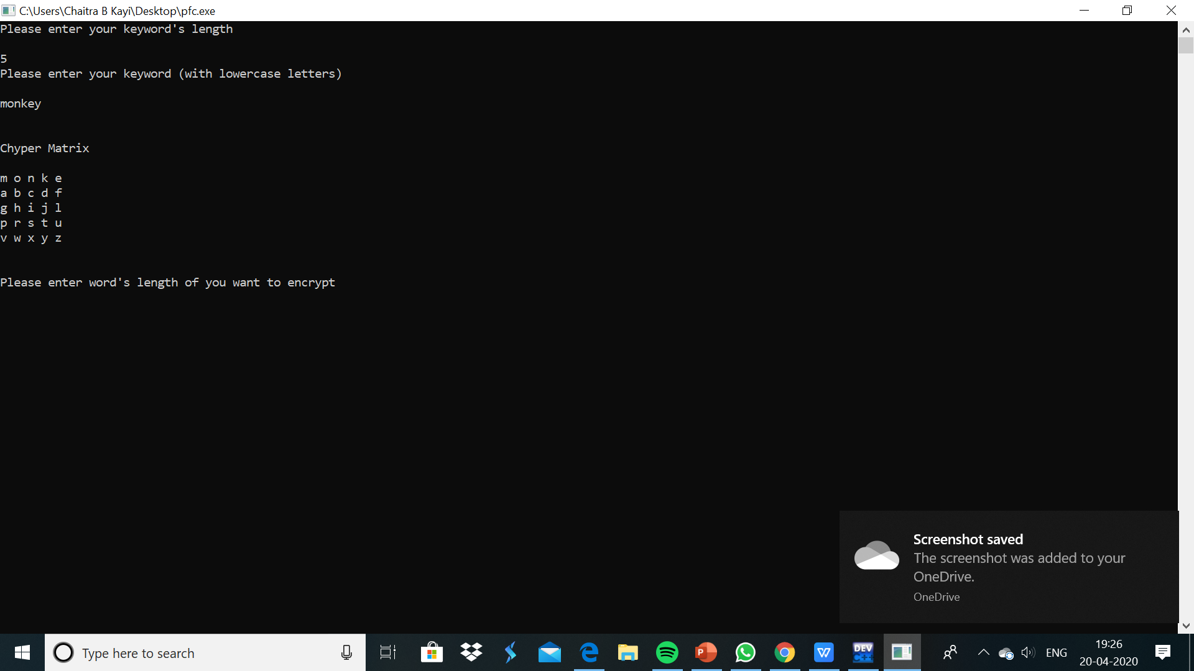

Slide 25
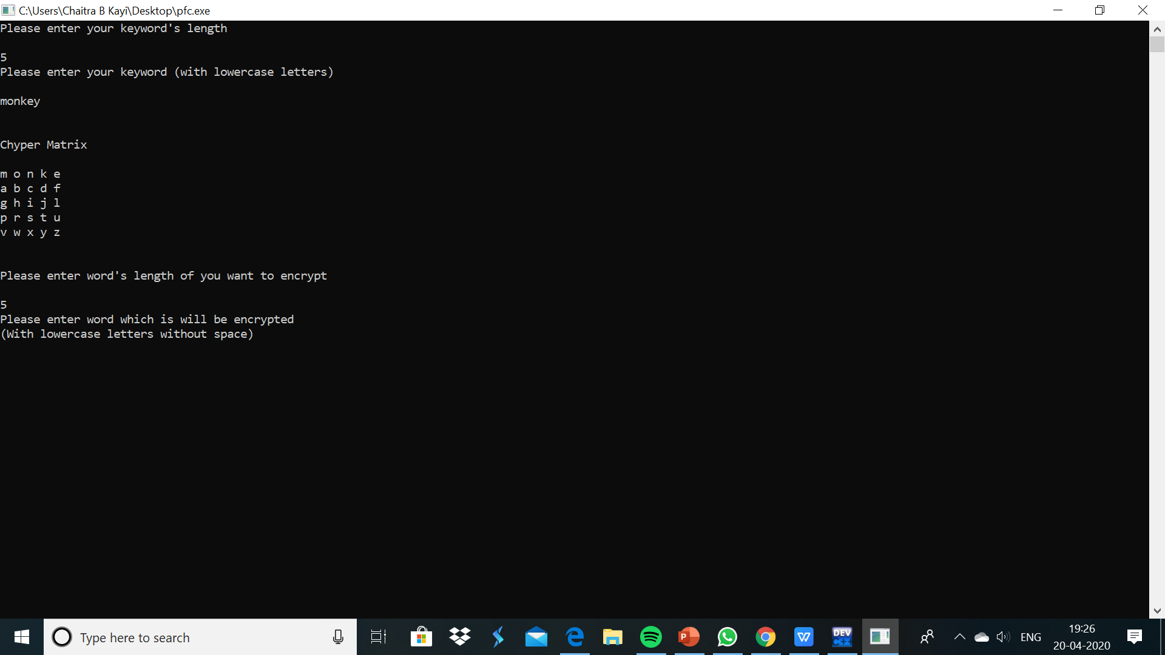

Slide 26
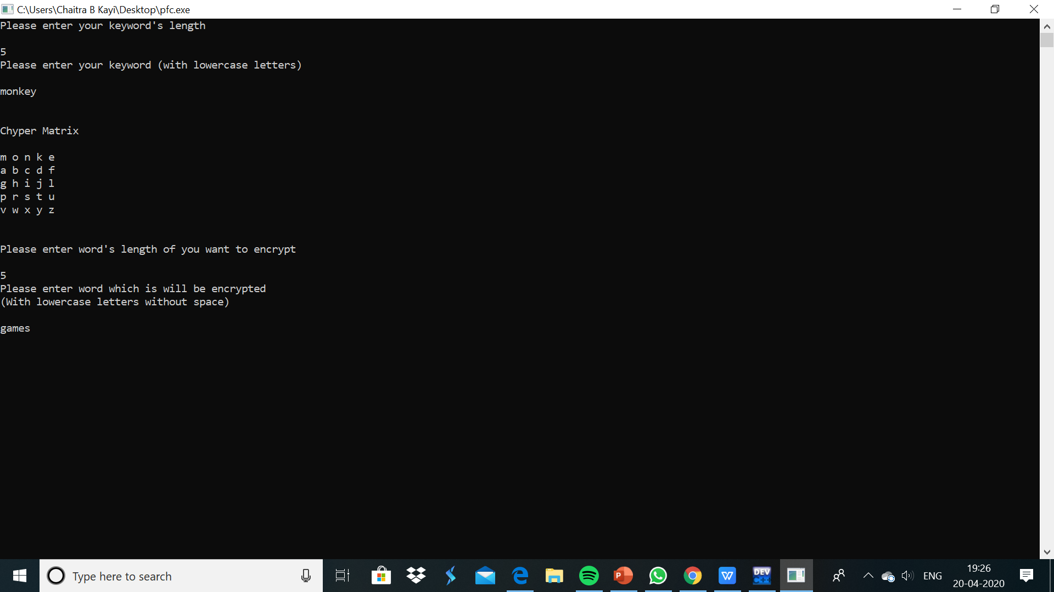

Slide 27
